Slide 1

Procurement
Afina Putri Dayanti 825200049
Eric Anthony 825200050

Slide 2
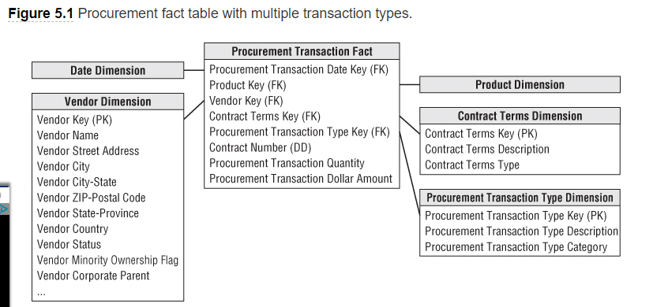
Procurement Transactions and Bus Matrix
As you begin working through the four-step dimensional design process, you determine that procurement is the business process to be modeled. In studying the process, you observe a flurry of procurement transactions, such as purchase requisitions, purchase orders, shipping notifications, receipts, and payments

Slide 3
Single Versus Multiple Transaction Fact Tables
As dimensional modelers, you need to make design decisions based on a thorough understanding of the business requirements weighed against the realities of the underlying source data. There is no simple formula to make the definite determination of whether to use a single fact table or multiple fact tables.
1
2
3
4
What are the users' analytic requirements?
Are there really multiple unique business processes?
Are multiple source systems capturing metrics with unique granularities?
What is the dimensionality of the facts?

Slide 4
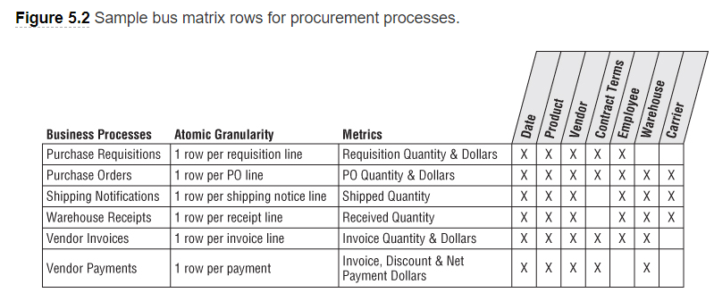
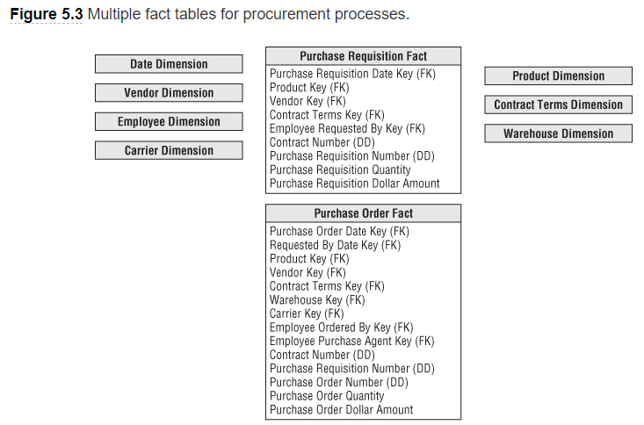
Single
Multiple
As illustrated in Figure 5.2, you can include two additional columns identifying the atomic granularity and metrics for each row. These matrix embellishments cause it to more closely resemble the detailed implementation bus matrix
as illustrated in Figure 5.3. In this example, there are separate fact tables for purchase requisitions, purchase orders, shipping notices, warehouse receipts, and vendor payments. This decision was reached because users view these activities as separate and distinct business processes, the data comes from different source systems, and there is unique dimensionality for the various transaction types.

Slide 5
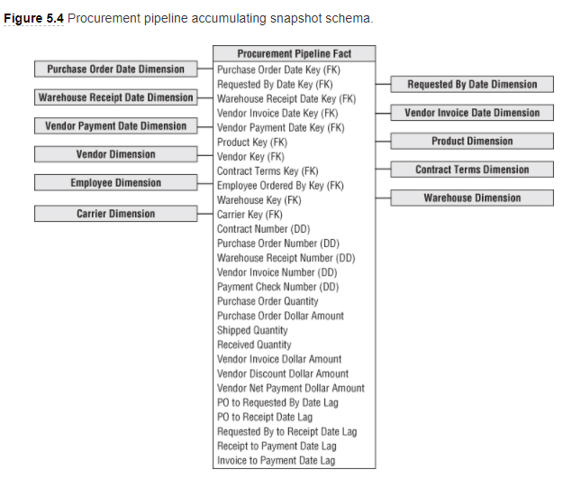
Complementary Procurement Snapshot
Apart from the decision regarding multiple procurement transaction fact tables, you may also need to develop a snapshot fact table to fully address the business's needs. As suggested in Chapter 4, an accumulating snapshot such as Figure 5.4 that crosses processes would be extremely useful if the business is interested in monitoring product movement as it proceeds through the procurement pipeline (including the duration of each stage). Remember that an accumulating snapshot is meant to model processes with well-defined milestones. If the process is a continuous flow that never really ends, it is not a good candidate for an accumulating snapshot.

Slide 6
Complementary Procurement Snapshot
Apart from the decision regarding multiple procurement transaction fact tables, you may also need to develop a snapshot fact table to fully address the business's needs. As suggested in Chapter 4, an accumulating snapshot such as Figure 5.4 that crosses processes would be extremely useful if the business is interested in monitoring product movement as it proceeds through the procurement pipeline (including the duration of each stage). Remember that an accumulating snapshot is meant to model processes with well-defined milestones. If the process is a continuous flow that never really ends, it is not a good candidate for an accumulating snapshot.

Slide 7
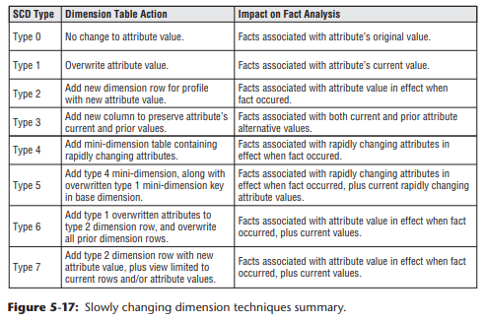
Slowly Changing Dimension Basics
To this point, we have pretended dimensions are independent of time. Unfortunately, this is not the case in the real world. Although dimension table attributes are relatively static, they aren't fixed forever; attribute values change, albeit rather slowly, over time. Dimensional designers must proactively work with the business's data governance representatives to determine the appropriate change-handling strategy. Although IT may assume accurate change tracking is unnecessary, business users may assume the DW/BI system will allow them to see the impact of every attribute value change. It is obviously better to get on the same page sooner rather than later.

